Slide 1

CECS 571 Fundamentals of Semantic Web Technologies COMPUTER ENGINEERING AND COMPUTER SCIENCE
Project 1: Semantic Data Generation
_{By}
_{Sai Vardhan Kondapaka}
_{Sai Mallesh Goud Dabbeti}
_{Sri Ram Prasad}
_{Ankit Ramrakhyani}
_{Under guidance of}
Dr. Bo Fu (Associate Professor)

Slide 2
Contents
Introduction
Software requirement/Technology stack
About Dataset
Future Scope/Questions
Overview of the Ontologies
Ontology Screenshots
Code Snippets
Technical Challenges
Output RDF format
References

Slide 3

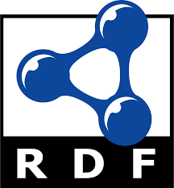
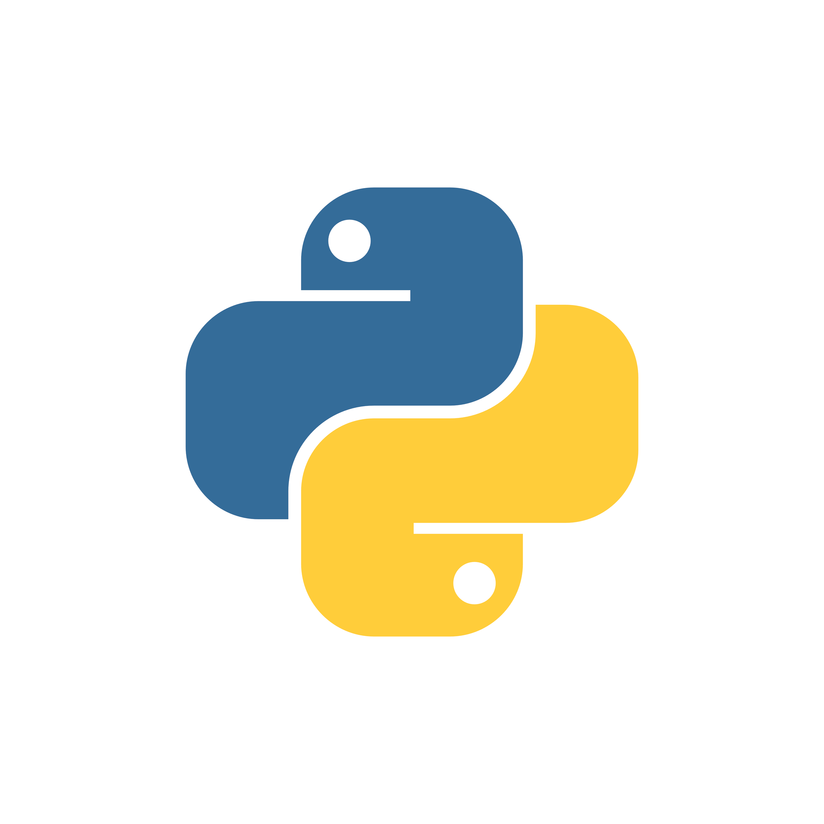
Introduction
This project is about Semantic Data Generation where input datasets are converted are into RDF(Resource Description Framework) files.
The ontology of the generated RDF file is then visualized using Protégé Ontology Editor.

Slide 4
Software requirement/Technology stack
Python- Python is an interpreted, object-oriented, high-level programming language with dynamic semantics developed by Guido van Rossum.
Protégé- Protégé is a free, open-source ontology editor and a knowledge management system used to save and visualize ontologies.
RDFLib- RDFLib is a Python library for working with RDF, a simple yet powerful language for representing information. This library contains parsers/serializers for almost all the known RDF serializations, such as RDF/XML, Turtle, N-Triples, & JSON-LD and install using ‘pip install rdflib’.
Visual Studio Code - Visual Studio Code is a code editor redefined and optimized for building and debugging modern web and cloud applications.

Slide 5
Datasets requirement
The datasets used are:
Film Locations in San Francisco, California- A listing of filming locations of movies shot in San Francisco starting from 1924. The first dataset contains titles, locations, fun facts. The second dataset contains titles, names of the director, writer, actors, and studio for most of these films.
Link- https://catalog.data.gov/dataset/film-locations-in-san-francisco
Why did you choose these datasets?
The dataset is available in a format that we can easily work with.
Ideally in an area you find more interesting and are personally motivated to explore.
In terms of licensing for use, the dataset is public and free to use.
The dataset is reliable enough to answer various types of user queries.

Slide 6
What kind of complex questions are you hoping to answer in the future?
The questions/queries ranging from simple to complex are as follows-
How many movies were directed by a director in a specific year?
Which is the most famous location for filming during particular time frame?
Number of releases from a production house during particular time period?
Number of movies which has common writer and director?
Which is the most repeatable/admirable director-actor duo?
The location chosen by a production house for a particular movie?
Which is the most favorite location for a particular director or/and production house?

Slide 7
Ontology/RDF Overview
Ontology-
An ontology is a formal description of knowledge as a set of concepts within a domain and the relationships that hold between them. It describes the semantics of the data, providing a uniform way to enable communication.
The word “semantic” implies meaning or understanding.
Semantic Web is concerned with the meaning of the data.
RDF-
The Resource Description Framework (RDF) is a general framework for representing interconnected data on the web. RDF is built around the existing Web standards: XML and URL (URI).
A Uniform Resource Identifier (URI) is a unique sequence of characters that identifies a logical or physical resource used by web technologies.
A URL identifies a web resource as well as its location on a computer network and how to access it.
A URN is a formal naming scheme that identifies a resource but does not indicate its location or how to access it.

Slide 8
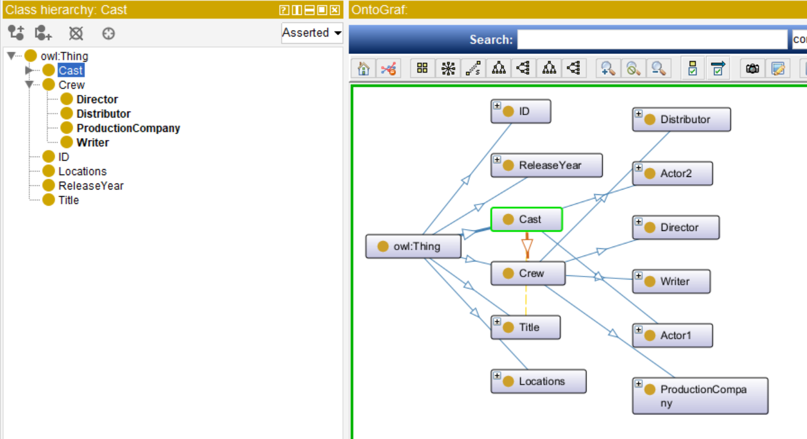
Ontology Screenshots

Slide 9
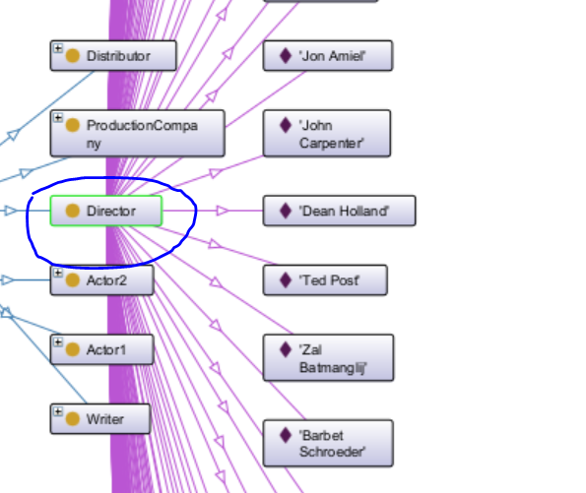
Ontology Graph (OntoGraf)

Slide 10
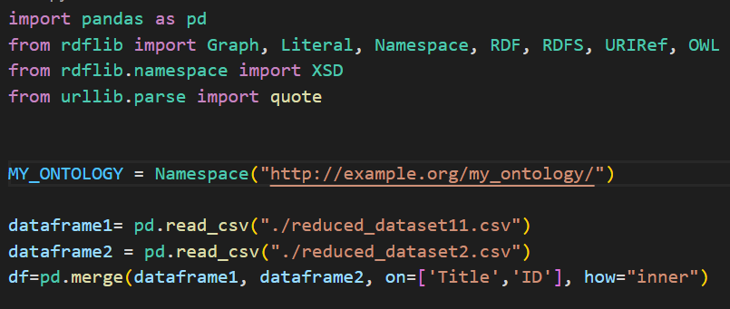
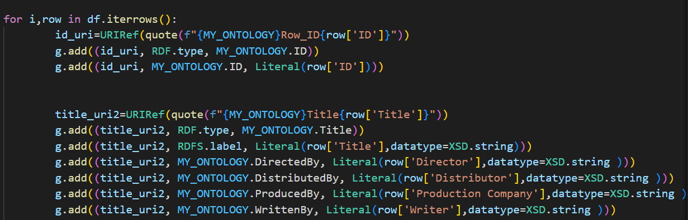
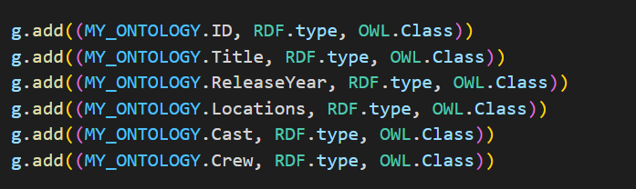
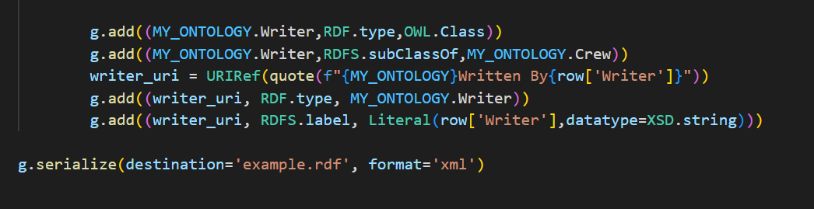
Code Snippets
.

Slide 11
Technical Challenges
Challenge - Reading and parsing through the datasets.
Overcame the issue by using CSV module, The CSV module implements classes to read and write tabular data in CSV format.
Challenge –Converting CSV data into valid RDF format for visualizing in Protégé
Overcame the issue by using RDF library to generate RDF graph and save data to an RDF file.

Slide 12
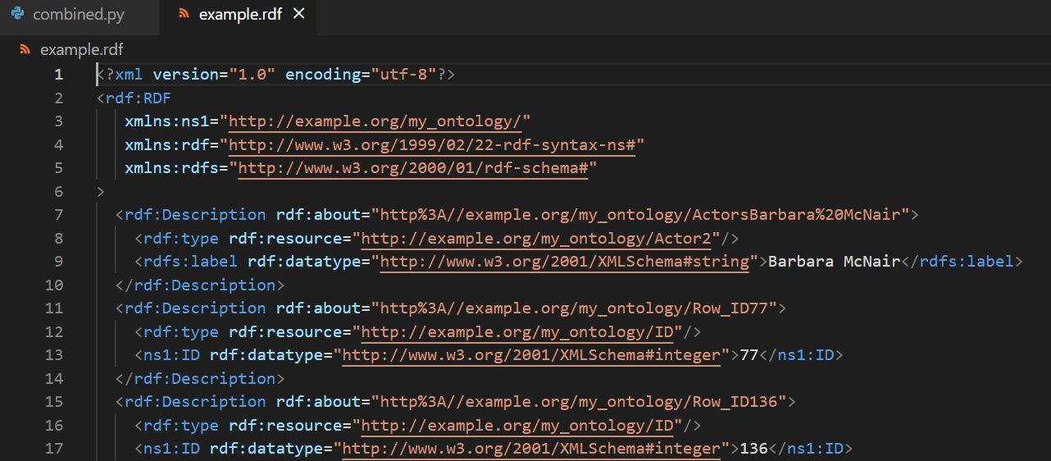
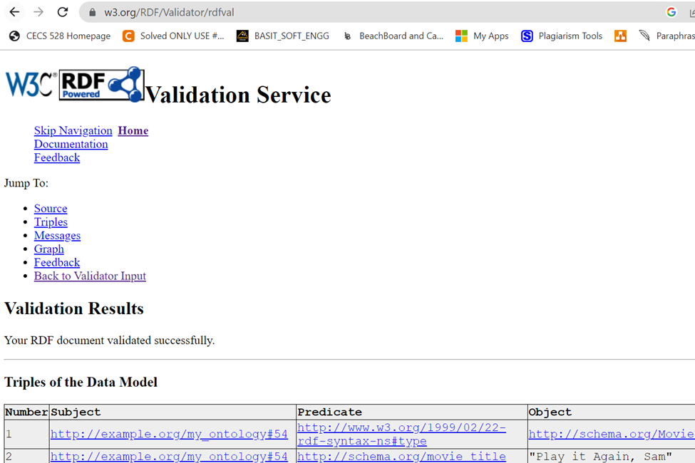
Output generated in RDF Format

Slide 13
References
Data.sfgov.org “Film Locations in San Francisco (2021)”
URL: https://catalog.data.gov/dataset/film-locations-in-san-francisco
Concepts and Abstract Syntax - https://www.w3.org/TR/rdf11-concepts/#section-rdf-graph
RDF Example - https://w3schools.sinsixx.com/rdf/rdf_example.asp.htm
Protégé Tutorial-https://cgi.csc.liv.ac.uk/~frank/teaching/comp08/protege_tutorial.pdf

